Slide 1

Java Programming Essentials: A Comprehensive Journey into Core Java and Beyond
Bharath Ashok

Slide 2

Day 15

Slide 3
Day 15: Agenda
Multi-Threading
Java Threads
Threads Synchronization
Threads States
Threads Communication
Threads Deadlock
Hands-on
Assignments
Interview Questions

Slide 4
Java Threads

Slide 5
Introduction to Multithreading in Java
What are Threads In Java
Definition of multithreading
Importance of multithreading for concurrent execution
Benefits of using multiple threads

Slide 6
Java.lang.Thread
What are Threads in Java:
In Java, a thread is the smallest unit of execution within a process.
Threads allow multiple tasks to be performed concurrently within a single program, enabling better utilization of system resources and improved responsiveness.
Each thread represents an independent sequence of instructions that can execute in parallel with other threads.
What is Multithreading: Multithreading is the concurrent execution of multiple threads in a single process. Each thread represents an independent flow of execution, allowing programs to perform multiple tasks concurrently.
Creating Threads: In Java, you can create threads by either extending the Thread class or implementing the Runnable interface. Implementing Runnable is generally preferred as it provides better separation of concerns.

Slide 7
Threads Creation Hands-on

Slide 8
Thread Synchronization
When multiple threads access shared resources, synchronization is necessary to prevent data inconsistency and race conditions.
Java provides the synchronized keyword and the Lock interface for synchronization.

Slide 9
Threads Synchronization Creation Hands-on

Slide 10
Threads States

Slide 11
Java Thread States
Threads can exist in various states throughout their lifecycle, reflecting their progress and activities.
New:
A thread is in the "New" state when it is just created but not yet started. In this state, the thread's start() method has not been called.
Runnable:
A thread is in the "Runnable" state when it's eligible to run but not currently executing. It might be waiting for its turn to use the CPU. Threads in this state can be executing or ready to execute.
Blocked/Waiting:
A thread is in the "Blocked" or "Waiting" state when it's waiting for a certain condition before it can continue execution. This can happen when a thread is waiting for a lock, I/O operation, or another thread to perform a specific action.
Timed Waiting:
A thread is in the "Timed Waiting" state when it's waiting for a specific period of time. This can occur when a thread calls methods like Thread.sleep() or Object.wait() with a specified timeout.
Terminated:
A thread is in the "Terminated" state when it has finished execution, either by completing its run method or being explicitly terminated. A terminated thread cannot be restarted.

Slide 12
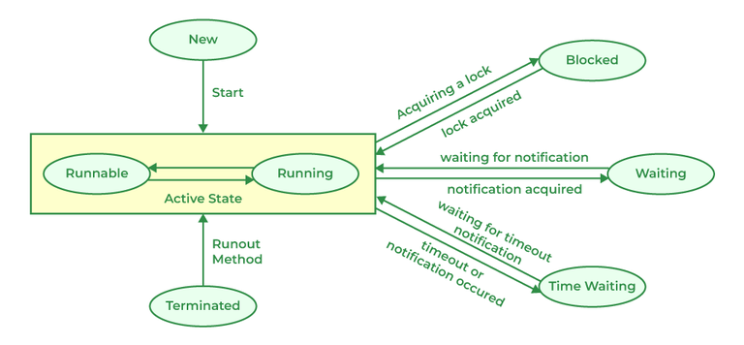
Java Thread States

Slide 13
Thread States Hands-on

Slide 14
Threads Communication

Slide 15
Threads Communication
Thread communication is the process of coordination and data exchange between multiple threads to achieve synchronized execution and shared resource management.
Threads often need to communicate to ensure proper execution order, prevent race conditions, and avoid deadlocks or other synchronization issues.
Java provides several mechanisms for thread communication:
Shared Resources:
Threads can communicate by sharing resources like data structures, objects, or variables. However, sharing resources without proper synchronization can lead to data corruption and synchronization issues.
Wait and Notify:
Java provides the wait(), notify(), and notifyAll() methods for threads to wait for a condition and signal other threads when the condition changes.
Condition Variables:
Java's java.util.concurrent.locks package provides advanced synchronization constructs, including Condition objects that allow threads to wait for specific conditions to be met

Slide 16
wait(), notify(), and notifyAll()
wait():
The wait() method is used to make a thread temporarily release the lock it holds and enter a waiting state until another thread invokes the notify() or notifyAll() method on the same object.
When a thread calls wait(), it waits until it receives a notification from another thread or until the specified timeout period elapses.
notify():
The notify() method wakes up one of the waiting threads that called wait() on the same object.
The choice of which thread to wake up is not deterministic and depends on the scheduler.
notifyAll():
The notifyAll() method wakes up all the waiting threads that called wait() on the same object.
This allows multiple threads to be notified simultaneously and gives them a chance to reacquire the lock and continue execution.

Slide 17
Threads Communication Hands-On

Slide 18
Thread Deadlocks

Slide 19
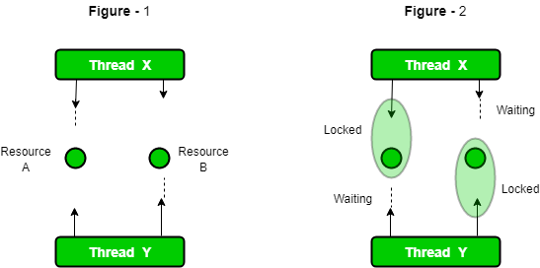
Deadlocks
A deadlock occurs in a multithreaded application when two or more threads are blocked, each waiting for a resource that the other thread holds.
As a result, none of the threads can make progress, leading to a situation to deadlock situation.
Deadlocks are a common synchronization issue in multithreaded programming and can be challenging to detect and resolve.

Slide 20

Dining Philosophers Problem
The potential for deadlock arises from the circular dependency in the order of acquiring forks:
Suppose philosopher A starts by locking its left fork (fork 1) and philosopher B starts by locking its left fork (fork 2).
Then, philosopher A tries to lock its right fork (fork 2), but it's already held by philosopher B.
Similarly, philosopher B tries to lock its right fork (fork 1), but it's already held by philosopher A.
At this point, both philosopher A and philosopher B are blocked, waiting for the other philosopher to release the fork they need. This creates a circular dependency, and neither philosopher can proceed. As a result, a deadlock occurs:
Philosopher A is holding fork 1 and waiting for fork 2.
Philosopher B is holding fork 2 and waiting for fork 1.

Slide 21
Threads Deadlock Hands-On

Slide 22
Thread Interruption

Slide 23
Thread Interruption
Thread interruption is a mechanism in Java that allows one thread to request the interruption or termination of another thread by setting the interrupted status of the target thread.
This is a way to gracefully communicate to a thread that it should stop its ongoing task and terminate, allowing the program to clean up resources and exit properly.
When a thread is interrupted, its interrupted status is set to true, indicating that the thread has been requested to stop.
However, it's important to note that thread interruption is a cooperative mechanism.
It doesn't forcefully stop the thread; instead, it's up to the interrupted thread to check its interrupted status and decide how to respond.

Slide 24
Threads Interruption Hands-On

Slide 25
try-finally With Thread Hands-On

Slide 26
Threads Starvation Hands-On

Slide 27
Daemon Threads
Daemon threads in Java are threads that run in the background and provide services to other non-daemon threads.
When all non-daemon threads have finished executing, daemon threads are automatically terminated, even if they are still running.
Daemon threads are often used for tasks that should not prevent the program from exiting when all other threads have finished their work.

Slide 28
Daemon Threads Hands-On

Slide 29
Java Executor Framework

Slide 30
Thread Pools
A thread pool is a collection of pre-initialized and reusable threads that are managed by a thread pool manager.
Thread pools are used to efficiently manage and reuse threads in multithreaded applications, which can improve performance, resource utilization, and the overall scalability of the application.
Different Types of Thread Pools:
newFixedThreadPool(int nThreads): Creates a fixed-size thread pool.
newCachedThreadPool(): Creates a dynamically sized thread pool.
newSingleThreadExecutor(): Creates a thread pool with a single worker thread.
newScheduledThreadPool(int corePoolSize): Creates a thread pool that can schedule tasks.

Slide 31
Executor Framework
Java provides built-in support for thread pools through the Executor framework, which is part of the java.util.concurrent package.
The main advantage of using thread pools is that you can avoid the overhead of creating and destroying threads for every task, which can be expensive
Creating a Thread Pool:
You can create a thread pool using one of the factory methods provided by the Executors class:
ExecutorService executor = Executors.newFixedThreadPool(5); // Creates a fixed-size thread pool
Submitting Tasks:
You can submit tasks (implementations of Runnable or Callable) to the thread pool for execution:
executor.submit(new MyTask());
Shutting Down the Thread Pool:
After all tasks have been submitted, it's important to shut down the thread pool to release its resources:
executor.shutdown();

Slide 32
Executor Framework Hands-On

Slide 33
Day 17

Slide 34
Day 17: Agenda
Callable
Java 8
Lambda
Functional Interfaces
Default and Static Methods
Hands-on
Assignments
Interview Questions

Slide 35
Callable Interface

Slide 36
Java.util.concurrent.Callable
The Callable interface in java.util.concurrent package allows to define tasks that can be executed asynchronously and return a result or throw an exception.
It's similar to the Runnable interface but with the addition of returning a result.
The call() method is the single abstract method in the Callable interface.
It represents the task that will be executed asynchronously and is responsible for performing the work. It can return a value of type V and can throw an Exception if necessary

Slide 37
Java 8

Slide 38
Features of Java 8
Lambda Expressions
Functional Interfaces
Default and Static Methods in Interfaces
Method References
Streams
New Date and Time API
Optional

Slide 39
Lambda Expressions

Slide 40
Lambda Expressions
A lambda expression in Java is a way to represent an anonymous function, also known as a lambda function or lambda.
It allows to define a block of code that can be passed around as a value and executed later.
Lambda expressions were introduced in Java 8 and are a fundamental feature of functional programming in Java.
EX:
(parameters) -> expression
(x, y) -> x + y
(str) -> str.length()
() -> "Hello, Lambda!“
Usage:
Runnable runnable = () -> {
System.out.println("Executing a lambda function!");
};

Slide 41
Functional Interfaces

Slide 42
Functional Interfaces
A functional interface is an interface that has exactly one abstract method (SAM), but it can also have multiple default and static methods.
Functional interfaces serve as the basis for working with lambda expressions and method references, enabling a more functional programming style in Java.
Key Characteristics:
Single Abstract Method (SAM)
Multiple Default and Static Methods
Examples of Functional Interfaces:
Consumer<T>: Represents an operation that accepts a single argument and returns no result.
Supplier<T>: Represents a supplier of results.
Predicate<T>: Represents a function that takes an argument of type T and returns a boolean.
Function<T, R>: Represents a function that takes an argument of type T and returns a result of type R.

Slide 43
Custom Functional Interfaces
Creating Custom Functional Interfaces:
@FunctionalInterface
interface MyFunctionalInterface {
int performOperation(int a, int b);
}
Creating Runnable with Lambda:
Runnable myRunnable = () -> System.out.println("Running!");

Slide 44
Hands-On

Slide 45
Default and Static Methods in Interfaces
Default and Static Methods in Interfaces

Slide 46
Default Methods
Default and static methods in interfaces were introduced in Java 8 to provide a way to add new functionality to existing interfaces without breaking the implementing classes.
A default method is a method defined in an interface with a default implementation.
It provides a default behavior that can be overridden by classes implementing the interface.
The primary purpose of default methods is to maintain backward compatibility with existing code while adding new functionality.
public interface MyInterface {
// Regular abstract method
void regularMethod();
// Default method with a default implementation
default void defaultMethod() {
// Default implementation
}
}

Slide 47
Static Methods
A static method in an interface is a method that is associated with the interface itself rather than with the instances of the implementing classes.
It is not inherited by the implementing classes and can only be called using the interface name.
EX:
public interface MyInterface {
// Static method
static void staticMethod() {
// Implementation
}
}

Slide 48
Hands-On

Slide 49
Method References

Slide 50
Method References
Method references in Java provide a concise way to refer to methods or constructors in a more compact and readable form.
They are often used in functional programming and lambda expressions, allowing you to treat methods as first-class objects
Method references simplify the code when you need to pass a method as an argument to another method.
There are four main types of method references in Java:
Reference to a Static Method
Reference to an Instance Method of a Particular Object
Reference to an Instance Method of an Arbitrary Object of a Particular Type
Reference to a Constructor

Slide 51
Reference to a Static Method
Sample Code:
// Lambda expression to find the length of a string
Function<String, Integer> lambda = str -> str.length();
// Method reference to String's length() static method
Function<String, Integer> methodReference = String::length;
int length1 = lambda.apply("Hello, Lambda!"); // Using lambda expression
int length2 = methodReference.apply("Hello, Method Reference!"); // Using method reference

Slide 52
Hands-On

Slide 53
Reference to an Instance Method of a Particular Object
Sample Code:
class MyClass {
public void print(String str) {
System.out.println(str);
}
}
MyClass myObj = new MyClass();
// Lambda expression to call print() on myObj
Consumer<String> lambda = str -> myObj.print(str);
// Method reference to call print() on myObj
Consumer<String> methodReference = myObj::print;
lambda.accept("Hello, Lambda!"); // Using lambda expression
methodReference.accept("Hello, Method Reference!"); // Using method reference

Slide 54
Hands-On

Slide 55
Reference to a Constructor
Sample Code:
class Person {
private String name;
public Person(String name) {
this.name = name;
}
public String getName() {
return name;
}
}
// Lambda expression to create Person objects
Supplier<Person> lambda = () -> new Person("Alice");
// Method reference to create Person objects using the constructor
Supplier<Person> methodReference = Person::new;
Person person1 = lambda.get(); // Using lambda expression
Person person2 = methodReference.get(); // Using method reference

Slide 56
Hands-On

Slide 57
Stream API

Slide 58
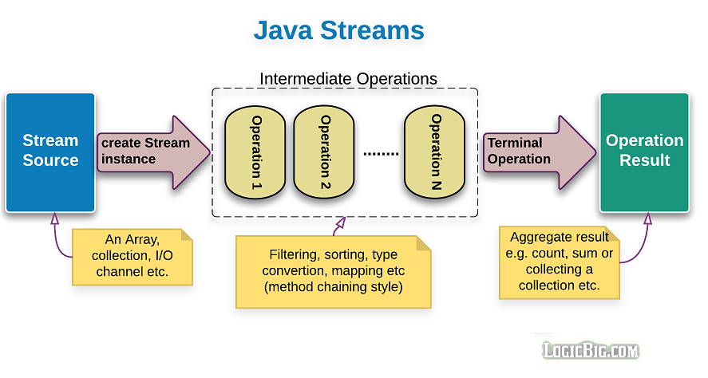
Stream API
The Stream API in Java is a powerful feature introduced in Java 8 that allows you to process sequences of data in a functional and declarative way.
It provides a higher-level abstraction for working with collections (e.g., lists, sets, and maps) and arrays.
Enables to perform various operations on the data, such as filtering, mapping and more, in a concise and expressive manner.
Key characteristics of the Stream API:
Stream:
Functional Operations
Lazy Evaluation

Slide 59
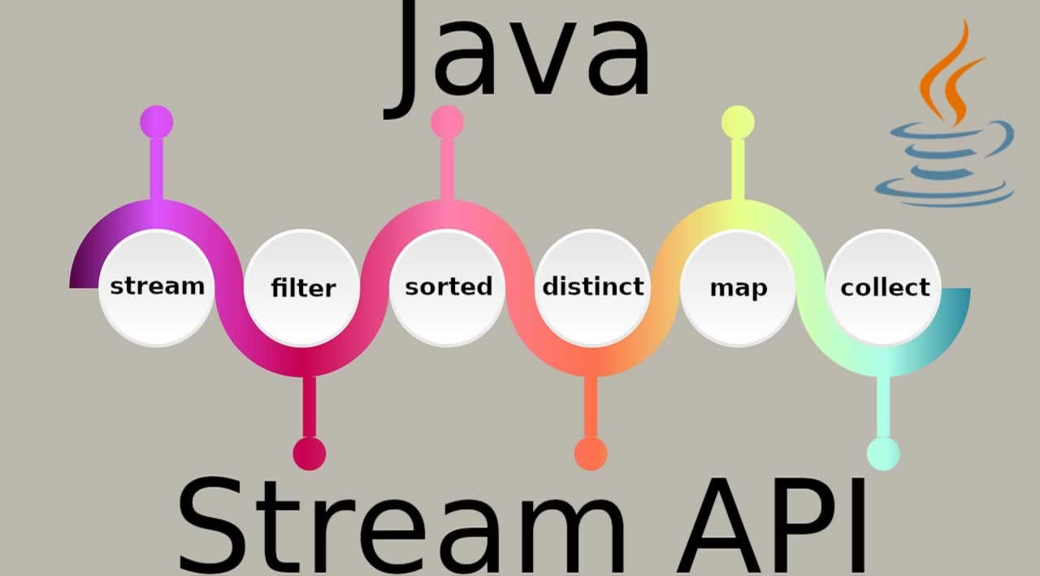
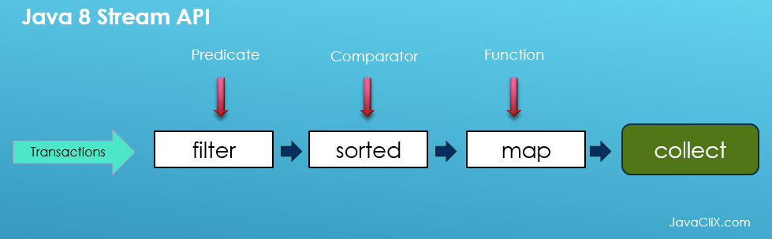
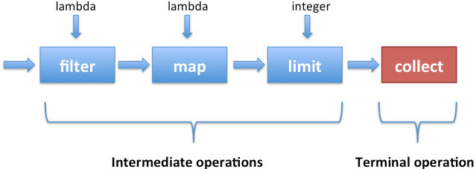
Key characteristics of the Stream API
Stream: A stream is a sequence of elements that can be processed in a pipelined fashion. Streams do not store data; they provide a way to access and manipulate data from a source (e.g., a collection, an array, or I/O channel)
Functional Operations: Streams support functional-style operations, which can be combined to create complex data processing pipelines.
Intermediate Operations: Common intermediate operations include filter, map, flatMap, distinct, sorted and more.
These operations are lazy.
Meaning they are only executed when a terminal operation is invoked
Terminal Operations:
Common terminal operations include forEach, collect, min, max, count, and toArray.

Slide 60
Hands-On

Slide 61
Optional Class

Slide 62
Java.util.Optional
The Optional class is a container object that may or may not contain a non-null value.
The Optional class encourages a safer approach to dealing with potential null values by providing a set of methods to work with these values.
Key Features:
Avoiding NullPointerExceptions
Container of values

Slide 63
Hands-On

Slide 64
Time API

Slide 65
Interview Questions

Slide 66
Hands-On

Slide 67
Multi-Threading Interview Questions

Slide 68
Multithreading Interview Questions
Explain what is thread in java?
How can you create a thread in Java? Provide examples.
What is the difference between a process and a thread?
What are the advantages of using multithreading in Java?
How does the Thread class in Java relate to multithreading?
What is the purpose of the Runnable interface?
How can you start a thread in Java?
How does the sleep() method work in Java threads?
Explain the concept of thread synchronization.

Slide 69
Multithreading Interview Questions
How can you achieve synchronization in Java?
What is the Java synchronized keyword used for?
Explain the difference between synchronized methods and synchronized blocks.
What is a deadlock in the context of multithreading? How can you prevent deadlocks in Java?
What is thread pooling? Why is it beneficial?
Describe the concept of thread priority in Java.
Explain the concept of thread communication.
What are Java's wait() and notify() methods used for?
How can you handle exceptions in a multithreaded environment?
What is the volatile keyword used for in Java multithreading?

Slide 70
Multithreading Interview Questions
What is the Java join() method used for?
Describe the Executor framework in Java.
What is the purpose of the Callable interface?
Explain the difference between the Runnable and Callable interfaces.
What is a race condition in multithreading, and how can it be prevented?
Explain the concept of context switching in multithreading.
What is the purpose of the ThreadLocal class in Java?
How can you interrupt a thread in Java?
Describe the concept of thread states in Java.

Slide 71
Multithreading Interview Questions
How can you check if a thread is alive in Java?
How do you handle thread interruption exceptions?
What is the java.util.concurrent package used for in Java?
Explain the concepts of a mutex and a semaphore in multithreading.
How can you implement a producer-consumer scenario using threads?
Describe the concept of thread-local storage and its use cases.
How does Java's ReentrantLock differ from the synchronized keyword?
How can you implement thread priorities effectively in a Java application?
Explain the concept of thread interruption and its use cases.
What is the significance of the Thread.currentThread() method?

Slide 72
Multithreading Interview Questions
What are daemon threads in Java, and how do they differ from user threads?
How can you create a thread-safe collection in Java?
Explain the concept of the happens-before relationship in the Java Memory Model.
What is the purpose of the ReadWriteLock interface in Java?
How does the ForkJoinPool class work in Java?
Explain the concept of thread dumping and how it can help troubleshoot issues.
What is the role of the ScheduledExecutorService in Java?
Describe the concept of thread naming in Java threads.

Slide 73
Multi-Threading Assignments

Slide 74
Multithreading Assignments
Simple Thread Creation and Execution:
Create a Java program that uses multithreading to simulate the execution of multiple tasks concurrently. Create and start multiple threads that perform different tasks, such as printing numbers or messages to the console.
Thread Synchronization:
Implement a scenario where two or more threads are accessing a shared resource (e.g., a bank account balance) concurrently. Use synchronization mechanisms such as the synchronized keyword or ReentrantLock to ensure thread-safe access to the shared resource.
Producer-Consumer Problem:
Implement a producer-consumer problem using threads. Create one or more producer threads that generate data, and one or more consumer threads that consume the data. Use a shared buffer to exchange data between producers and consumers, ensuring that the buffer is synchronized properly.

Slide 75
Multithreading Assignments
Bank Account Transactions:
Design a multithreaded program that simulates bank account transactions. Implement threads for depositing and withdrawing money from an account. Use synchronization to prevent overdrawing.
Multithreaded Quiz Game:
Develop a simple quiz game where questions are displayed to users and they need to provide answers within a certain time. Use threads to manage the countdown and user input.
Simulation of a Restaurant:
Model a restaurant scenario with multiple customers, waiters, and cooks. Use threads to simulate customers ordering, waiters serving, and cooks preparing food.

Slide 76
Q&A

